Slide 1
Decision Tree

Slide 2
Classification—A Two-Step Process
Model construction: describing a set of predetermined classes
Each tuple/sample is assumed to belong to a predefined class, as determined by the class label attribute
The set of tuples used for model construction is training set
The model is represented as classification rules, decision trees, or mathematical formulae
Model usage: for classifying future or unknown objects
Estimate accuracy of the model
The known label of test sample is compared with the classified result from the model
Accuracy rate is the percentage of test set samples that are correctly classified by the model
Test set is independent of training set (otherwise overfitting)
If the accuracy is acceptable, use the model to classify new data
Note: If the test set is used to select models, it is called validation (test) set

Slide 3
Process (1): Model Construction
Classification
Algorithms
Training
Data
Classifier
(Model)
IF rank = ‘professor’
OR years > 6
THEN tenured = ‘yes’

Slide 4
Process (2): Using the Model in Prediction
Classifier
Testing
Data
Unseen Data
(Jeff, Professor, 4)
Tenured?

Slide 5
Decision Tree Induction: An Example
Training data set: Buys_computer
The data set follows an example of Quinlan’s ID3 (Playing Tennis)
Resulting tree:
age?
<=30
overcast
>40
31..40
student?
yes
credit rating?
no
yes
excellent
fair
no
yes
no
yes

Slide 6
Algorithm for Decision Tree Induction
Basic algorithm (a greedy algorithm)
Tree is constructed in a top-down recursive divide-and-conquer manner
At start, all the training examples are at the root
Attributes are categorical (if continuous-valued, they are discretized in advance)
Examples are partitioned recursively based on selected attributes
Test attributes are selected on the basis of a heuristic or statistical measure (e.g., information gain)
Conditions for stopping partitioning
All samples for a given node belong to the same class
There are no remaining attributes for further partitioning – majority voting is employed for classifying the leaf
There are no samples left

Slide 7
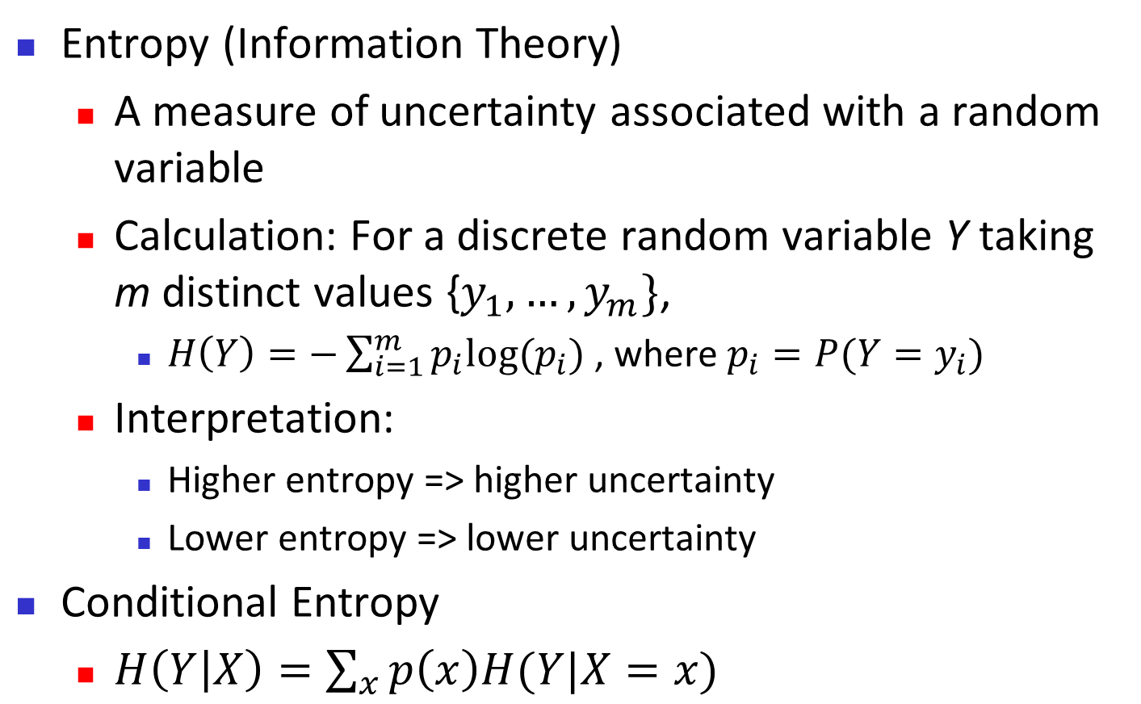
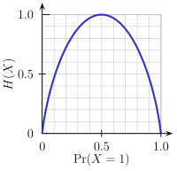
Brief Review of Entropy
m = 2

Slide 8
Attribute Selection Measure: Information Gain (ID3/C4.5)
Select the attribute with the highest information gain
Let p_{i} be the probability that an arbitrary tuple in D belongs to class C_{i}, estimated by |C_{i, D}|/|D|
Expected information (entropy) needed to classify a tuple in D:
Information needed (after using A to split D into v partitions) to classify D:
Information gained by branching on attribute A
Notes:
I : the expected information needed to classify a given sample
E (entropy) : expected information based on the partitioning into subsets by A

Slide 9
Attribute Selection: Information Gain
Class P: buys_computer = “yes”
Class N: buys_computer = “no”
means “age <=30” has 5 out of 14 samples, with 2 yes’es and 3 no’s. Hence
Similarly,

